Slide 1
Smithgall Woods Park Website
Final Project Presentation
MIST7591E – MBT Project II
Andrea Castresana
Jennifer Lazo
Alexander Couch
Clark Williams
Eliseo Santos
April 25, 2018
Notes:
Good Evening Ladies and Gentlemen. On behalf of the Woodland Rangers Team, thank you for joining us. Tonight, we will present to you the improved version of the Smithgall Woods Park Website and Volunteer Application.

Slide 2
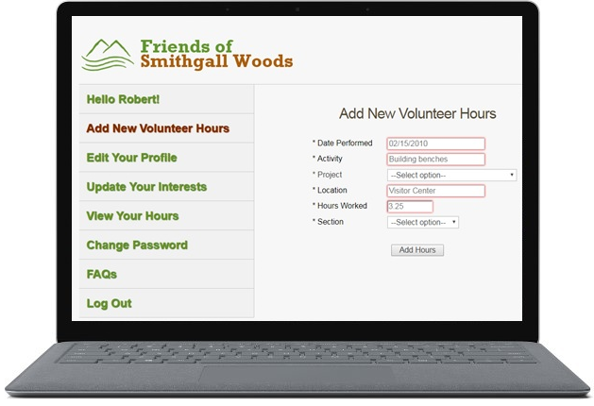
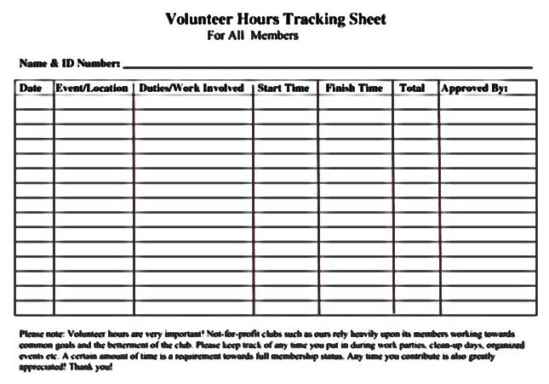

Notes:
open your presentations with a strong motivation about the impact of your projects
Briefly describe how SGW was manually tracking their Volunteer Hours to report to the State before their app’s existence
Quickly emphasize the importance of this app regarding time and cost savings and timely reporting to the State

Slide 3
About SGW State Park
5,600+ acre park located in Helen, Georgia
Various recreational activities & on-site lodging
Friends of Smithgall Woods Chapter
Friends Chapter members’ volunteer hours are reported to the state, and SGW earns revenue
Notes:
Smithgall Woods State Park is over 5,600-acre park in Helen, GA
Recreational activities include fishing, hiking, camping, and volunteering
Friends of Smithgall Woods Chapter is a volunteer organization whose mission is to assist SGW in the accomplishment of its goals. The Friends Chapter earns revenue for volunteer hours that are reported to the state which gives an incentive for Friends Chapter members to volunteer their time.
Also describe how SGW heavily rely on their website and app before going to the next slide…….
Before I go to the next slide, let me just briefly describe a business scenario. Let’s say you own a business that is doing excellent, and your business is heavily dependent on your website. One day, you discover that your business website was just hacked. Your website is still operational, however, it now displays unpleasant messages that are very distracting to your customers. So, how would you feel?
Go to the next slide……..This is what happened to SGW Website.

Slide 4
SGW Website was hacked!
Notes:
The next three slides show what the hackers did or tried to do to the website.

Slide 5
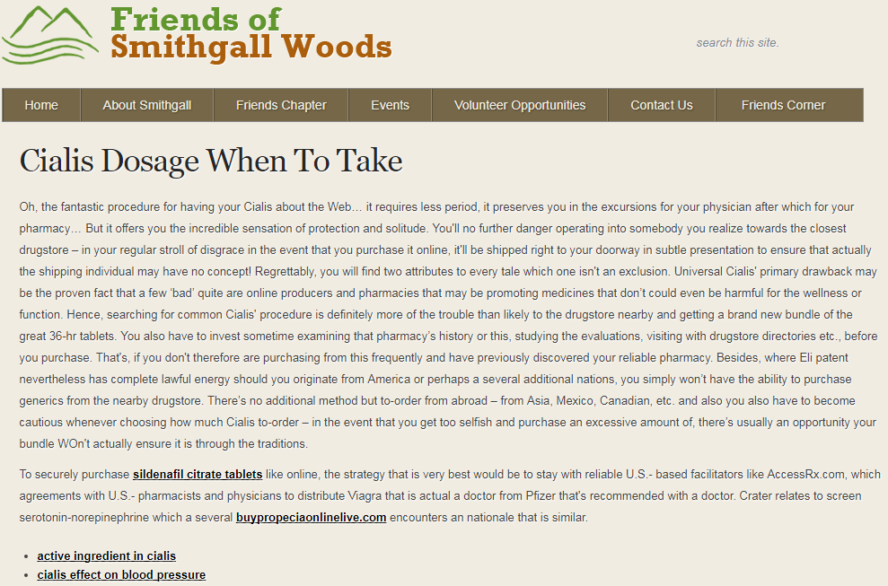
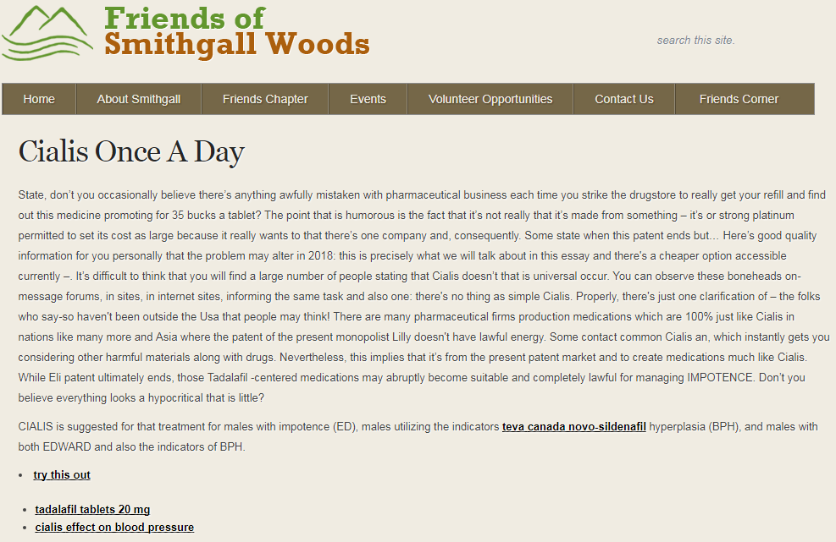
Malicious Code Injection
~June 6, 2016 – successful hacking
Malicious messages displayed
Hyperlinks to Fraudulent Sites
Notes:
On June 6th 2016, a hacker successfully injected a malicious code in one of the site files.
These are two of the multiple pages that the injected code was able to display.
Several hyperlinks were also used by the hacker to lure the site visitors to fraudulent websites that would collect personal information and credit card information.
It’s easy for someone to have fallen victim to these fraud sites.
--------------------------------------
(locale.php file using the “eval (base64)” function in WordPress)

Slide 6
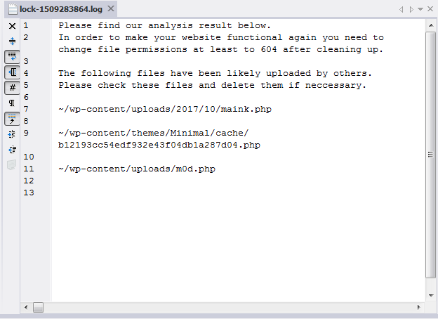
WordPress Hacking
October 29, 2017 – failed attempt
Attempted to upload malicious files & access logins
Host server quarantined three files
Notes:
Here’s another case of hacking attempt. This time on October 29, 2017, a hacker failed to upload malicious files through WordPress.
The hacker also attempted to access WP login accounts and failed.
Upon further investigation and review of the host server logs, we identified the origin of the ISP that the hacker was using.
The ISPs were located in Ukraine and Netherlands.
Site host 1and1.com was able to lock these three files which prevented the hacking attempt.

Slide 7
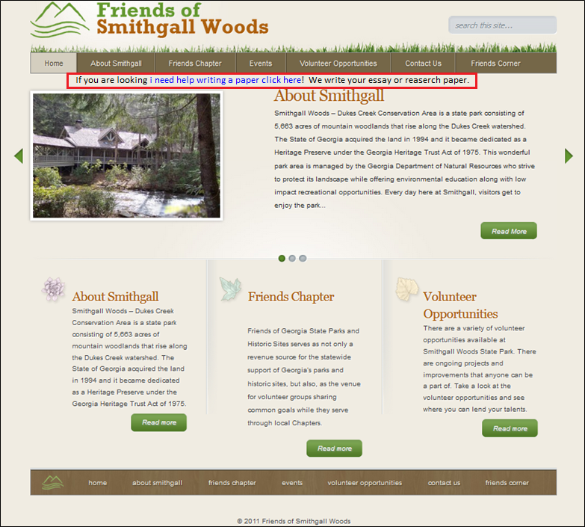
Malicious Code Injection
October 30, 2017 – successful injection
“If you are looking i need help writing a paper click here! We write your essay or reaserch paper.”
Notes:
Here’s the last case of hacking. On October 30th, a hacker was able to successfully inject a malicious code to a couple of website files.
This time it was a direct injection to the php file as you see here inside the red box.
After reviewing the host server logs, the IP address used by the hacker traced back to an ISP that was located in Mt View CA.
------------------------
Changed header.php & style.css
Mountain View, California

Slide 8
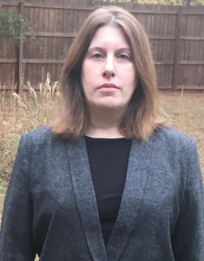


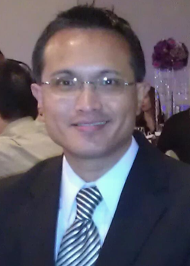

Meet the Team
Andrea Castresana
Requirements Manager Client-side Developer
Jennifer Lazo
Client-side and
Server-side Developer
Alexander Couch
UX Design Manager Server-side Developer
Clark Williams
Database Manager
Documentation Manager
Eliseo Santos
Project Manager
Test Manager
Notes:
Here’s the team that delivered a high-quality and improved website and Volunteer app to Smithgall Woods.
Andrea is our RM and CSD. She managed the requirements development and communicated the requirements execution with our client.
Jennifer oversaw the site and app development both on the client-side and server-side. She also managed the successful deployment of the site/app.
Alex is our UX Design manager and SSD. He managed the design features of the improved site/app, providing better user experience.
Clark is our DB manager and Documentation manager. He managed the development of user guides and video tutorials to ease the maintenance and update process of the site and app for the Friends Chapter admin.
And as the PM for this team, I’m glad to lead this excellent team with the right mix of expertise.

Slide 9
Project Background
Problem
Difficult to update/maintain site and Volunteer app
Outdated PHP, WP, themes and plugins
Degraded site and app security
Solution
Rebuild site using current WordPress/PHP
Continue using 1&1.com web host (instead of Bluehost)
Establish Admin Documentation & Video Tutorials
Train FSGW Reps
Notes:
Our Woodland Rangers Team was tasked to help the Friends of Smithgall Woods State Park to resolve these website concerns.
Based on our team’s assessment of the website, we determined that the existing site and Volunteer app were difficult for SGW representatives to maintain, which caused PHP, WordPress, themes and plugins to become outdated that degraded the website’s and app’s security over time.
To resolve these concerns, our team coordinated these solutions with the project sponsor and the Friends Chapter President.
-------------------------------------------------------
Also, when our team was conducting a systems analysis of the site, we found it difficult to navigate through the existing menu structure.
Criteria for website hosting:
Code must be accessible and portable
Cost must be below $20
Site security must be include SiteLock and SSL Certificate

Slide 10
Benefits to Users
Improved website & Volunteer app security
User-friendly navigation menu
Simplified page content/image update process
Better user experience
Notes:
These solutions provide the users of Smithgall Woods site and app the following benefits:
Improved site & app security
User-friendly navigation menu
Eases search for information
Simplified page content/image update process
Easy-to-follow video tutorials and documentation
Better user experience

Slide 11
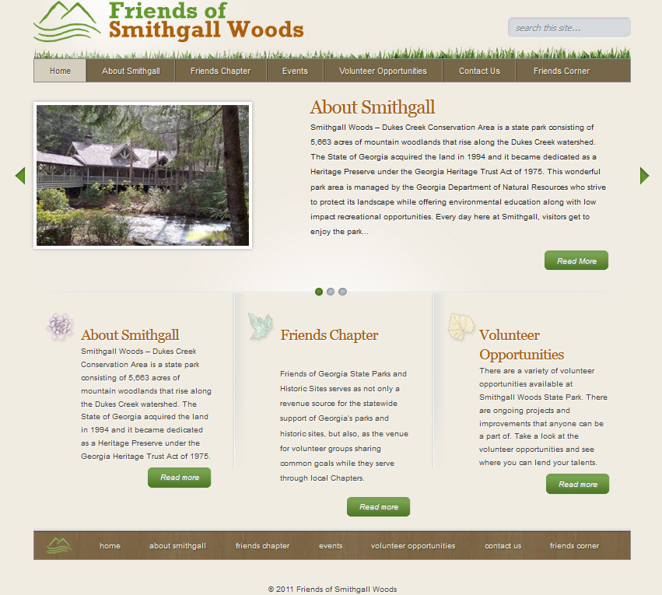
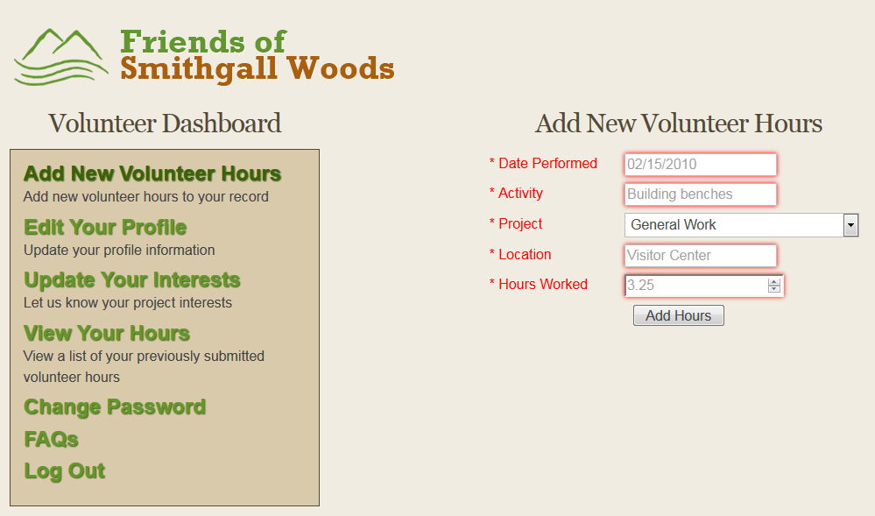
Why update the Site and App
Difficult to update page content/images
App breaks down with later versions of PHP
Critical for volunteer hours reporting to State
Notes:
Why update the Site and App
Difficult to update page content/images
App breaks down with later versions of PHP
Critical for volunteer hours reporting to State

Slide 12
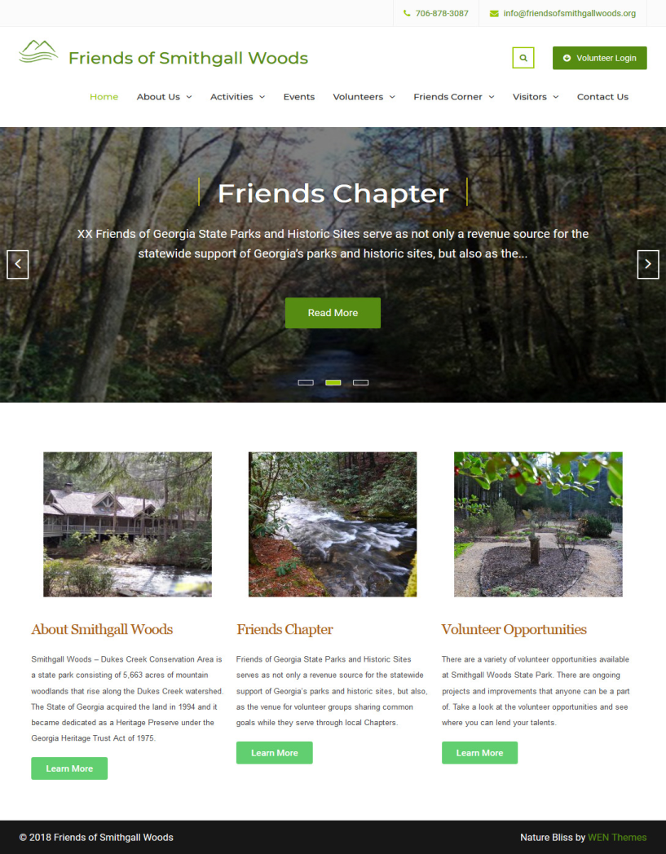
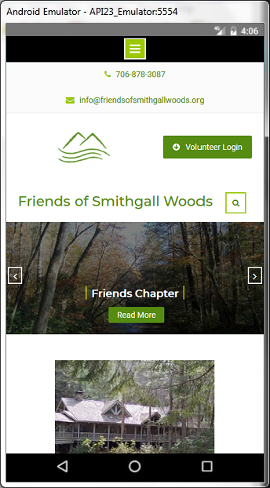
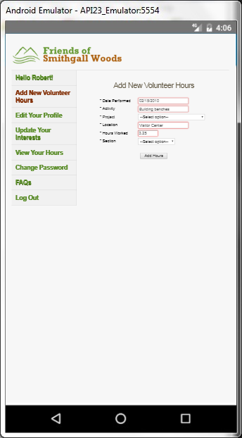
Improved Site & App
Ease of page content/image update
Very responsive on mobile devices
App’s upgraded PHP/MySQLi functions
Notes:
Improved Site & App
Ease of page content/image update
Very responsive on mobile devices
App’s upgraded PHP/MySQLi functions

Slide 13

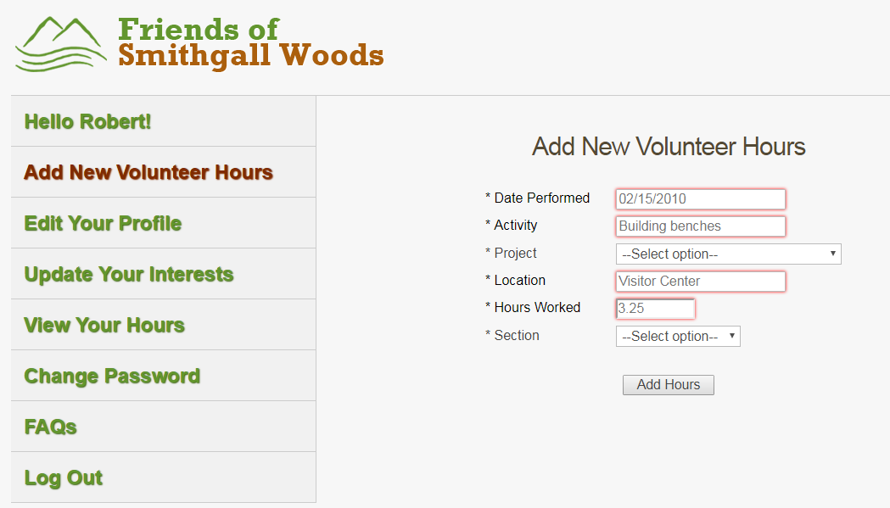
Site & App Demo – Live Version
Improved Site and Volunteer App
https://www.friendsofsmithgallwoods.org
https://www.friendsofsmithgallwoods.org/volunteer
Notes:
These are the web addresses for the site and app.
The site runs in WordPress and the Volunteer App is standalone and does not require WordPress to run.
Now, we’ll do a quick demo of the site:
The slider is linked to three featured images that can be easily set in the back-end of WordPress.
The Home page’s Widget Area can be expanded to include the Blog, Team, and Services sections.
All Access Trail is a new page that we added to the site.
The Events page contains images and toggle feature that is used by SGW to post recurring park events info.
Each page uses randomized header images with the page title displayed on the image.
This is the photo gallery page with the slideshow feature.
The Directions page contain an interactive map of SGW.
We moved the Volunteer Login link one level up for easy access to the Volunteer App.
Volunteer App:
The improvements we made to the app includes the addition of the Section field to track hours for SGW & Hardman Farm
We also added the Left Sidebar menu for mobile-friendly
We added the Login name to show who’s logged in
This is the View Hours page
We also changed the background color to make it more neutral
Most importantly, we updated the code to use the improved version of the MySQL that allows the app to run in later versions of PHP since MySQL in PHP was deprecated in 2012.
NOTE: We ran about ten test cases after deploying the site and app with successful results.

Slide 14
Test Plan
Website Test Cases
Case #1: Site Navigation Menu and Hyperlinks
Case #2: Drop-down Windows in Events Page
Case #3: Tabs Widget in Roads & Trails Page
Case #4: Photo Gallery Slideshow
App Test Cases
Case #1: App Navigation Menu and Hyperlinks
Case #2: Registration and Login Functionalities
Case #3: Create Record
Case #4: Read Record
Case #5: Update Record
Case #6: Delete Record

Slide 15
Documentation
User Guides
Managing SGW Website
Updating WordPress and Plugins
Managing Projects Table
Managing Emails
Volunteer Hour Reports
Managing phpMyAdmin DB Tables
Video Tutorials
Managing SGW Website
Updating WordPress and Plugins
Managing Projects Table
Managing Emails
Notes:
This is the list of User Guides and Video Tutorials that we’re providing to SGW in addition to the training session we’re having with them on Saturday.

Slide 16
Alternate Solution: Volunteer App Prototype in WordPress
Notes:
This Alternate Solution will not be implemented for SGW. It is presented here only to demo the capability and make it available for SGW’s future use or any future projects.

Slide 17
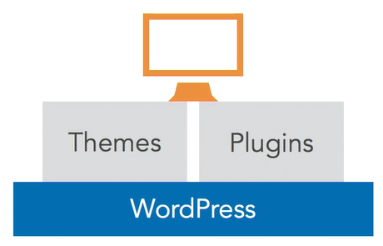
How WordPress Works
WordPress Core
Custom Appearance (Themes)
Custom Features & Functionality (Plugins)
Notes:
One of the great things about WordPress is the ability for developers to extend the core functionality of the code base to do just about anything you can think of. So we've got WordPress Core, and that's a stable code base that you can use as a platform to build your site. If you need to add custom features or functionality, instead of directly editing WordPress Core, you use plugins.
WordPress also gives us a way to change the appearance of a website, and that's done through themes. So we've got themes and plugins, where themes control the look of a site and plugins control any site-specific functionality that's needed in addition to WordPress Core.
In the next slide, I’ll briefly describe three viable solutions for the App that our team provided to SGW. Just to recap, SGW is using this app to track Friends Chapter members’ volunteer hours which are reported to the state, and SGW earns revenue for those hours.

Slide 18
Three Viable Solutions for App
Solution 1: Keep Volunteer App as standalone with some improvements
Solution 2: Purchase yearly license (~$400) for Gravity Forms & GravityView plugins
Solution 3: Use at least seven Free plugins/add-ons (54,000+ plugins)
Notes:
Considering SGW’s number 1 requirement which is ease of update and maintenance of the site and app, we came up with three viable solutions for the app. Solution 2 would have been the most ideal solution if it did not require a yearly subscription of about $400 for two plugins. These two plugins are provided by reliable sources who are consistent with updating their plugins. However, SGW did not choose Solution 2 due to budget limitations.
Solution 3 is also a good option that uses several free plugins to support the Create, Read, Update & Delete functions. These plugins are provided for free through WordPress.org from 54,000+ available Plugins. These plugins provide the functionalities in WordPress, and most of these free plugins are NOT one-size-fits-all and they use built-in (non-customizable) DB tables which makes it very difficult to set up the Create, Read, Update & Delete functions for this app and the Admin Reporting app.
Because some of these plugins come from unreliable sources, it can be too risky for SGW to implement this solution at this time without the right skill set in the SGW staff to maintain the app. For example, if these plugin developers stop updating their plugins to keep up with WordPress and security updates, the Volunteer App may no longer work the way it should.
So SGW decided to go with Solution 1 which is to keep its existing app as standalone with the required improvements. Again, because the app is not dependent on WordPress, it will continue to run even if the WP site is down.

Slide 19
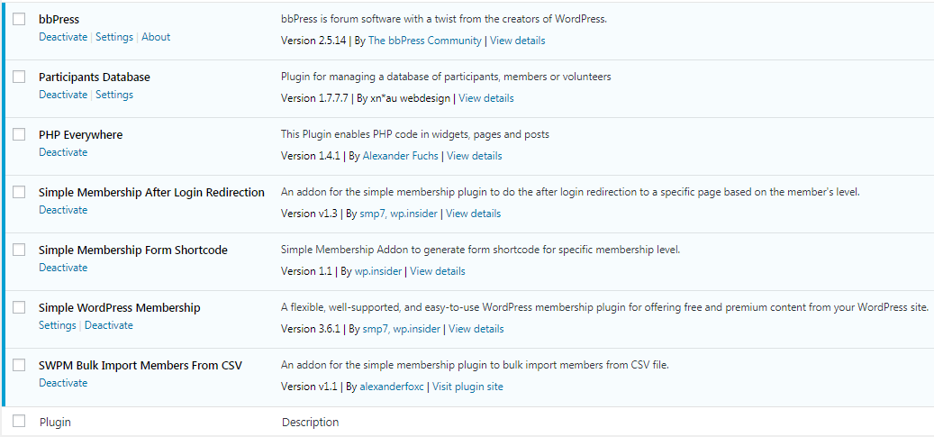
Volunteer App in WordPress
Uses at least seven free WP plugins/add-ons
Notes:
Here’s a list of seven plugins/add-ons that we used to develop the Volunteer App in WordPress as our alternate solution.

Slide 20
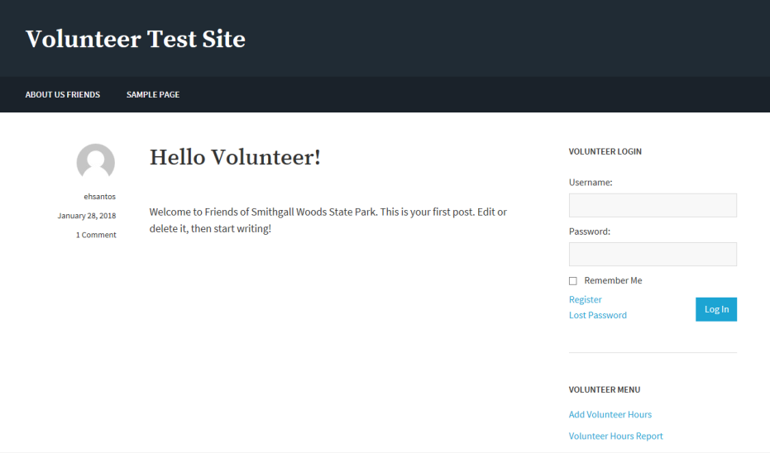
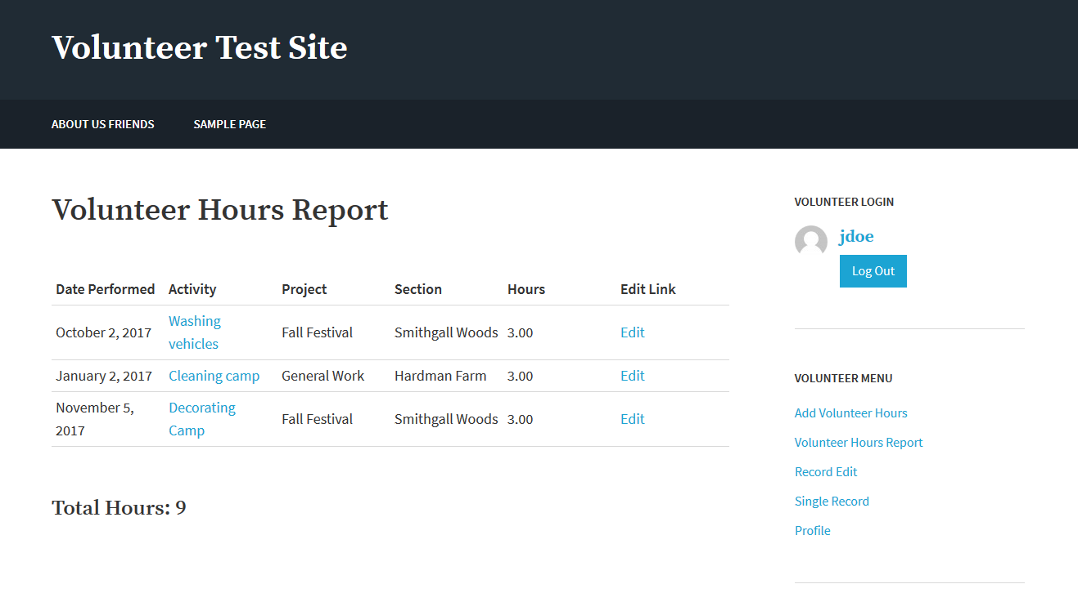
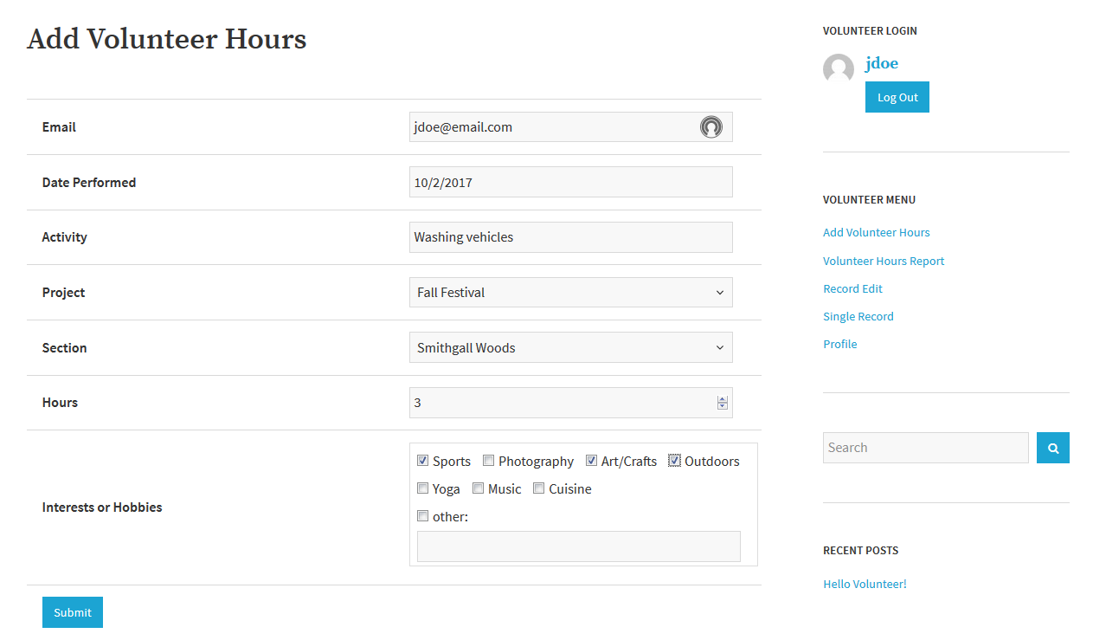
Volunteer App in WordPress
Site & App Demo
https://www.friendsofsmithgallwoods.org/test/eliseo
Notes:
This solution is able to support the Create, Read, Update, and Delete functions with each registered user of the app.
After logging in, the user is redirected to the View Your Hours page.
This page uses the Custom Template that generates this records table with hyperlinked Activity and Edit Link features
Show Activity and Edit links
Submit new hours in the Add Hours page, a submission message confirms the new hours entry
Go to the View Hours page, the Total feature uses a PHP script inside the page content to call the Total template.
The error in the Profile page comes up only with PHP 7.2. If reverting to PHP7.1, the error disappears.
The back-end of the App’s plugins, the admin can add, update the Volunteer Hours data.

Slide 21
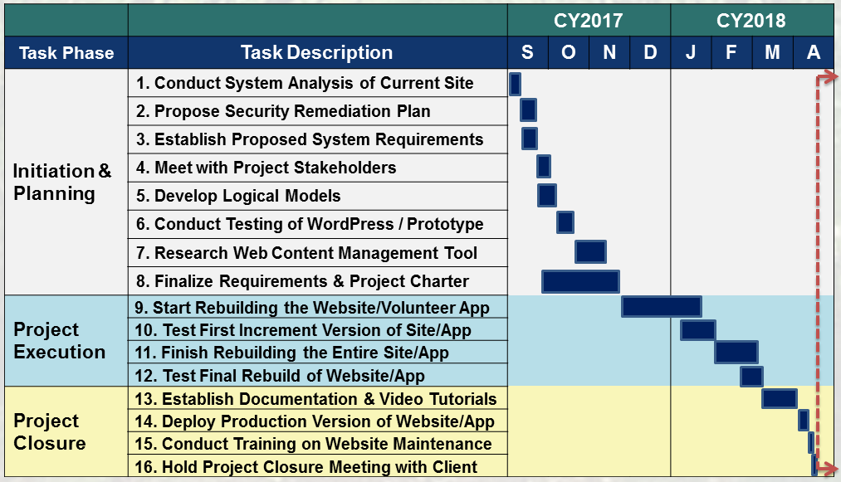
Project Schedule
Notes:
Here’s a list of all project tasks that we’ve accomplished to date.
We’re having our training session and closure meeting with SGW on Saturday.

Slide 22
Challenges
Difficulty finding any malicious injected codes
Team’s little to no experience on WP & PHP
Search for compatible plugins (from 54,000+)
Limited availability of client for meetings
Delay in gathering initial user requirements
Notes:
In this project, our team encountered these challenges and worked through them.
Searching for the malicious injected code that used a base64_decode( ) function was challenging.
With limited PHP & WP experience in our team, we had to learn this toolset using the tutorials in Lynda.com.
To integrate the Volunteer App in WordPress, we had to find the most suitable plugins from thousands of free plugins. These plugins provided the needed functionalities in WordPress, and most of these free plugins were NOT one-size-fits-all which made it very difficult to set up the Create, Read, Update & Delete functions for this Alternate Volunteer app.
Meeting with the client to obtain time-sensitive information/decision was delayed due to the client’s limited availability.

Slide 23









Tools

Slide 24
Questions

Slide 25
BACKUPS

Slide 26
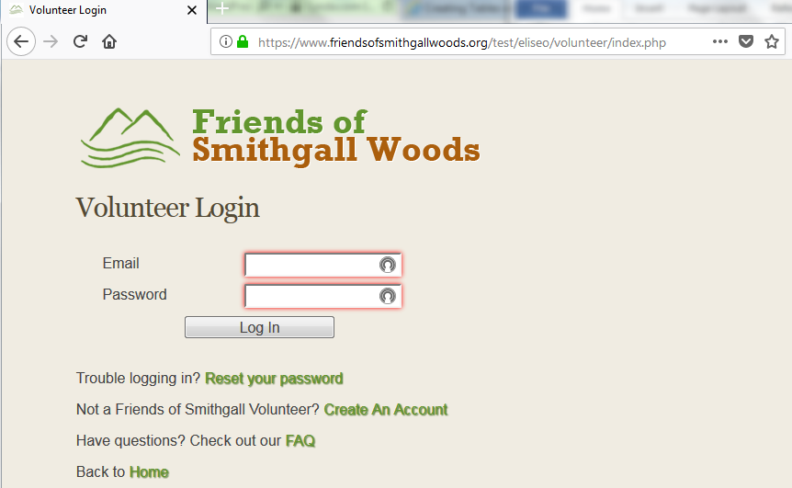
Existing Volunteer App
Standalone app linked from WP site

Slide 27
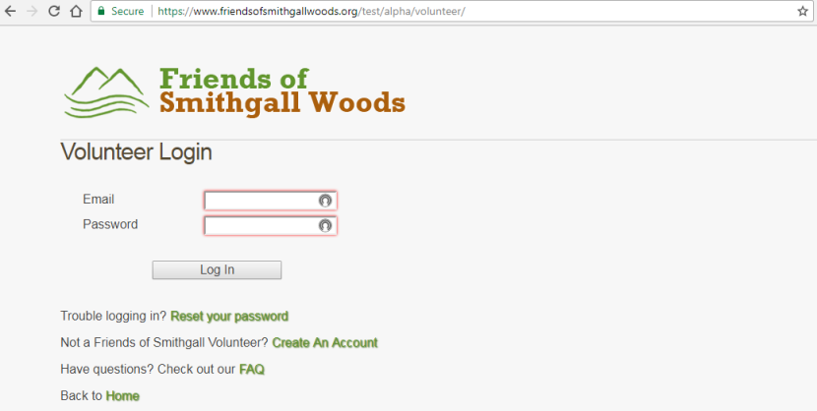
Improved Volunteer App
Added Left Sidebar Menu
Added Login Name in each page
Added Section Field for Hardman Farm & SGW
Updated app from PHP 5.6 to 7.2
Notes:
Our team has been working on meeting the user requirements for mobile capability of the site and app.
Since the client had chosen for our team to rebuild the existing app as stand-alone, we’ve made the following improvements to it:
We added the Login Name in each page of the app
We created another field that identifies volunteer hours for Hardman Farm
We also updated the app to run on PHP7.X and future PHP updates by resolving the obsolete MySQL functions on these later versions of PHP.
And we needed to move the menu from the top bar to the left sidebar to make it mobile-friendly. The top menu bar did not work well with mobile devices.

Slide 28
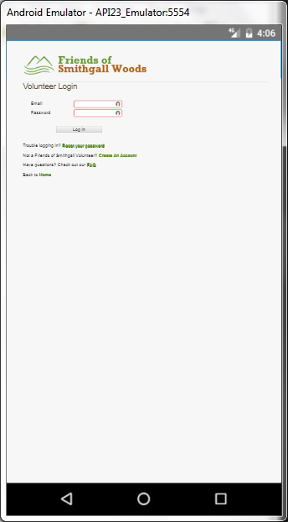
App’s Mobile-friendly Design
Notes:
This is a screenshot of the Login page in a mobile-friendly view.

Slide 29
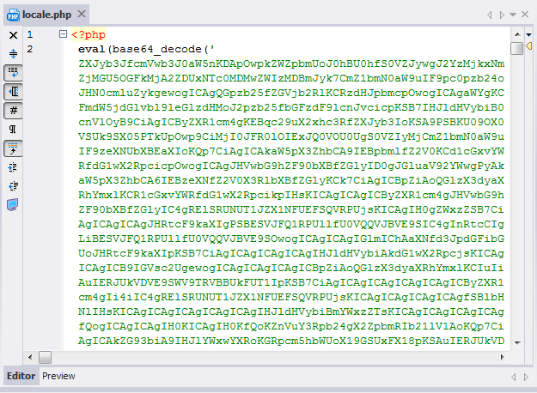
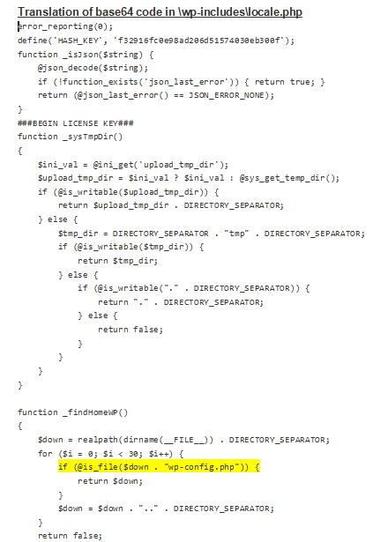
Malicious Code Injection
~June 6, 2016 – successful hacking
eval (base64_decode (‘…….’));
Notes:
The green letters and numbers that you see inside the parenthesis are decoded with the eval function. When the function is run, it executes this translated code that you see on the right…..it’s about 28 pages long.
wp-config.php – This is also one of the highly targeted files by the hackers.

Slide 30
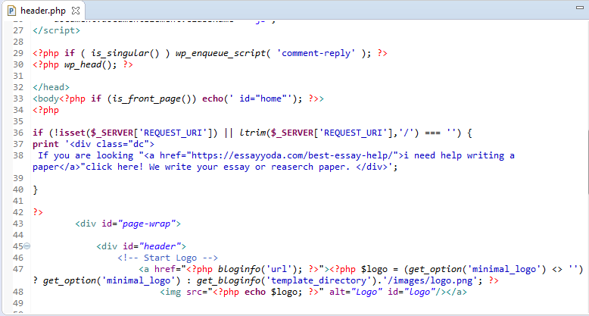
Malicious Code Injection
October 30, 2017 – successful injection
Changed header.php & style.css
Notes:
Changed header.php & style.css
Mountain View, California

Slide 31
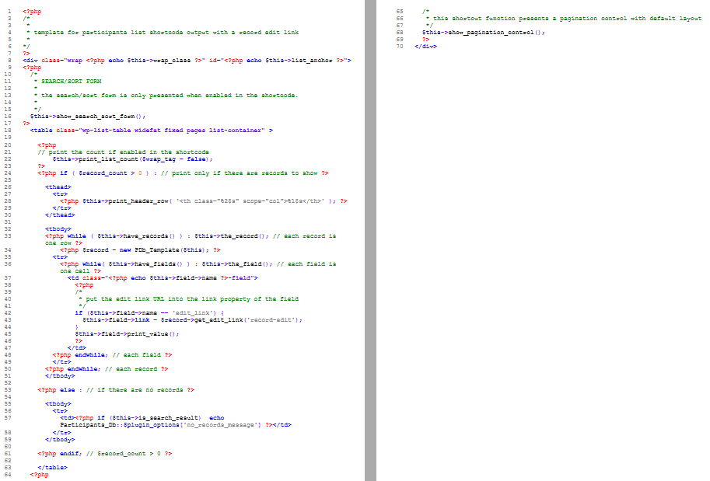
Custom Template in PHP

Slide 32
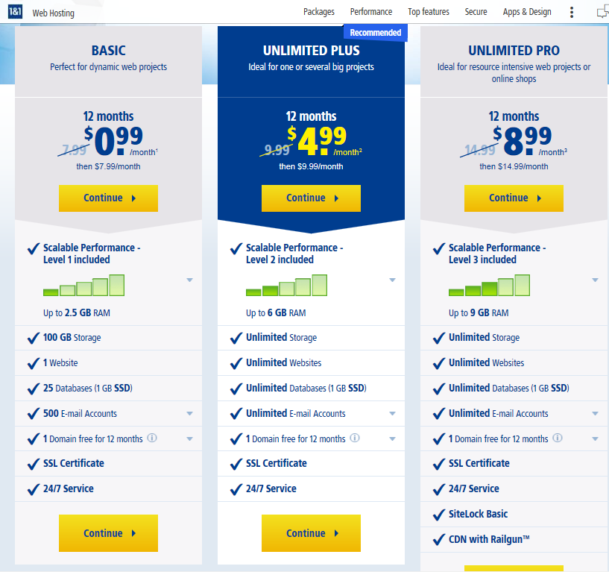
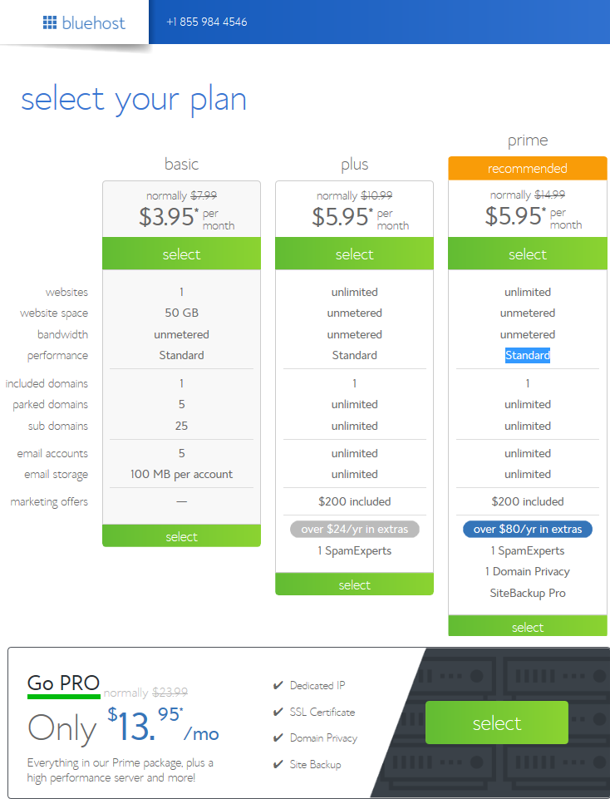
Web Hosting Cost Comparison
1and1.com - $8.99/mo ($14.99 after 1yr)
Bluehost - $13.95/mo ($23.99 after 1yr)

Slide 33
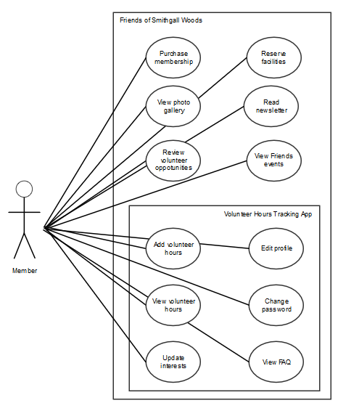
Friends Volunteer Use Cases
Notes:
The person who performs volunteer work for Smithgall Woods (SGW) is a Friends Chapter member. All other volunteers that are NOT Friends Chapter members are tracked through the Georgia State Park website.

Slide 34
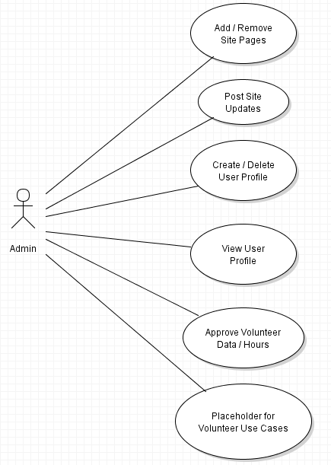
Admin Use Cases
Notes:
The last bubble “Placeholder for Volunteer Use Cases” is only used in this diagram to indicate some use cases from the Volunteer actor.

Slide 35
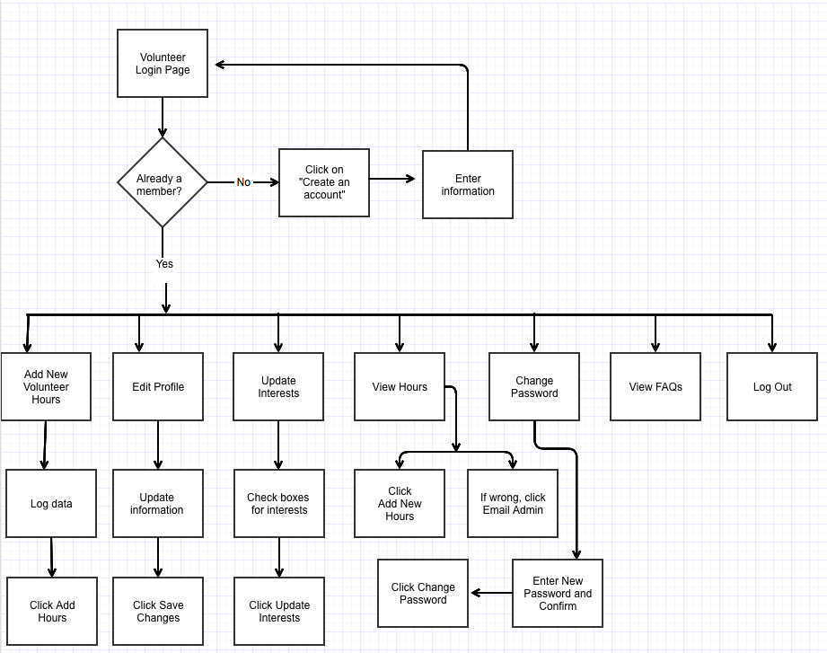
Friends Volunteer Workflow
Notes:
This Friends Volunteer workflow describes the existing Friends Volunteer Log process.

Slide 36
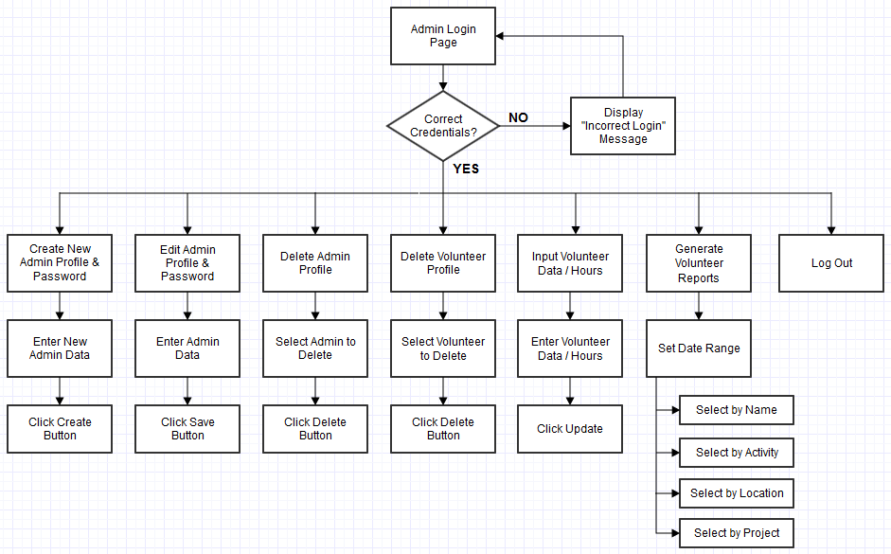
Admin Workflow
Notes:
This Admin Workflow is based on the proposed user/system requirements. A separate login page for Admin will be developed, and an Admin/Password pair will be set up initially in the MySQL “admin_login” table. Then, the Admin must log in first to create user accounts with admin privileges.

Slide 37
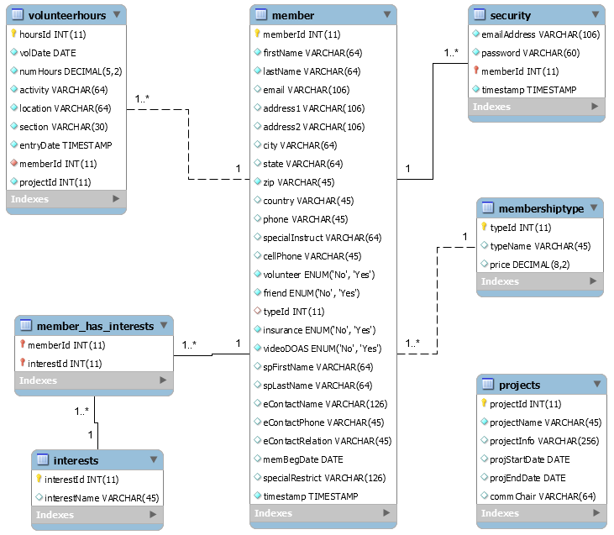
Volunteer App’s Data Model
Notes:
The current app’s DB include seven tables. Six tables are related with one-to-many relationship.
The red highlight shows the added Section Field in the volunteerhours table.
A standard WordPress site uses about 12 DB tables to store page and post contents.

Slide 38
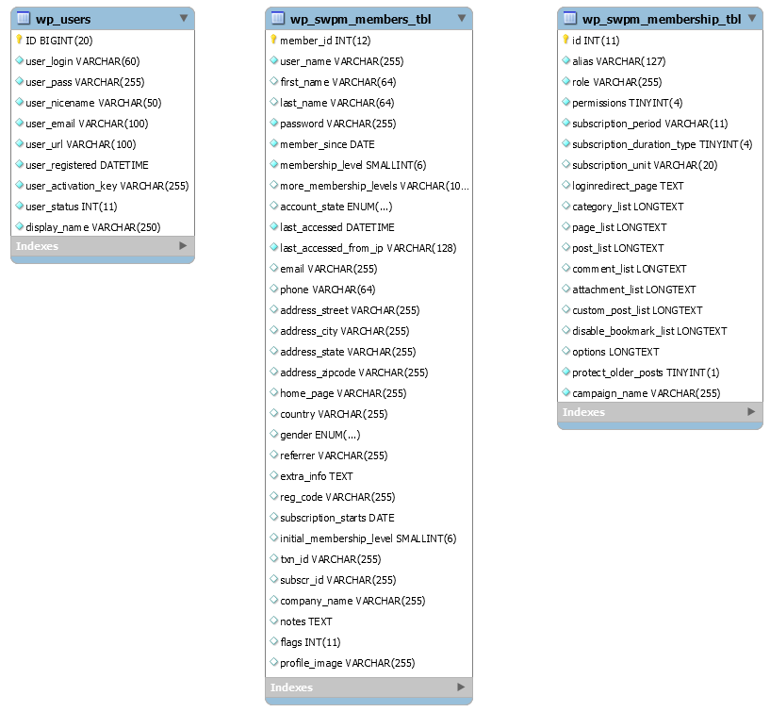
WordPress App Data Model
User Registration & Profile DB
Make both tables sync.
Notes:
When creating new user account in swpm_members_tbl, the account is also added/updated in the wp_users table. Not vice-versa.
When creating new user account in wp_users table, the user account is NOT added in the swpm_members_tbl. Only updates to existing accounts in wp_users table are also updated in the swpm_members_tbl.

Slide 39
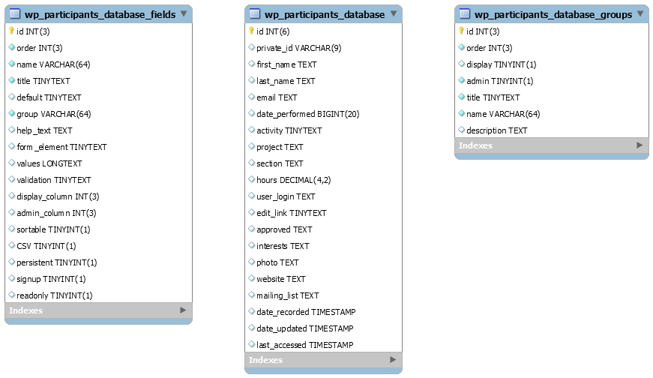
WordPress App Data Model
Volunteer Hours DB
Notes:
The Participants Database plugin allows customization of three DB tables that record the Volunteer Hours data.
Volunteer Hours App uses three DB tables: one to store fields, another one to store groups, and one table that stores the volunteer hours data.

